Slide 1
HackXplore Team: Goose Aryan Dangat Atharva Prabhu Nitish Bhosle Spandan Deb
AI-Driven College Event Planning System A smart platform that automates event management, enhances committee collaboration, and optimizes attendee engagement. Leveraging AI, it streamlines PR, task allocation, real-time communication, and post-event analytics.

Slide 2
Problem Statement:
Organizing college events—tech fests, cultural festivals, sports meets, or seminars—is complex, requiring coordination across PR, marketing, logistics, and technical teams. Real-time challenges like communicating properly, task assignments, and attendee engagement make the process inefficient. Traditional tools lack intelligent automation, and ease of completion. Thus leading to miscommunication and increased manual workload.
KEY AREAS TO EXPLORE
Committee-Based Event Management – AI-driven task allocation, adding events dynamically .
Automated PR & Marketing – AI Content Suggestions ,AI powered video and image generation.
Event Tech Integration – Centralized upcoming events page, online registrations, AI based content suggestions, sharing of messages on different platforms and budget optimizer.
Post-Event Analytics – Analytics on feedback and performance reviews. It will help us to plan the future events in a better manner.

Slide 3
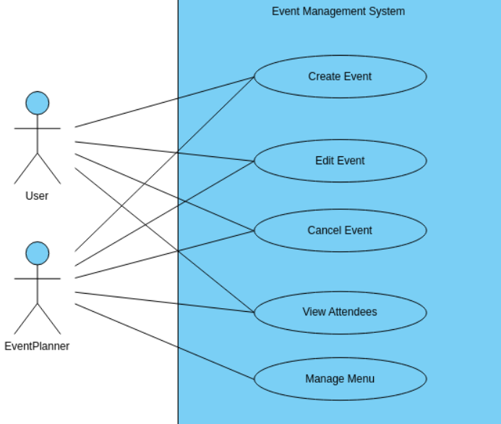
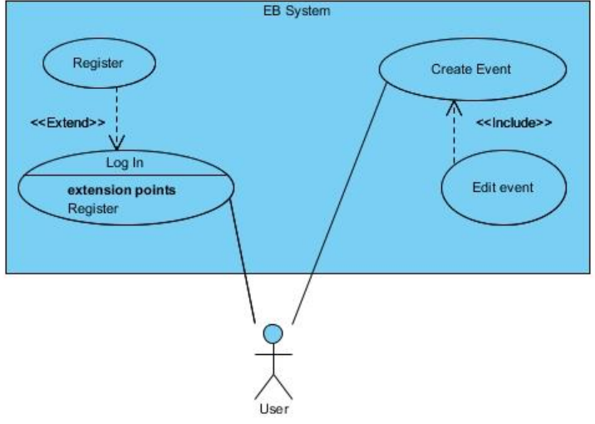
Proposed design (user case diagram):

Slide 4
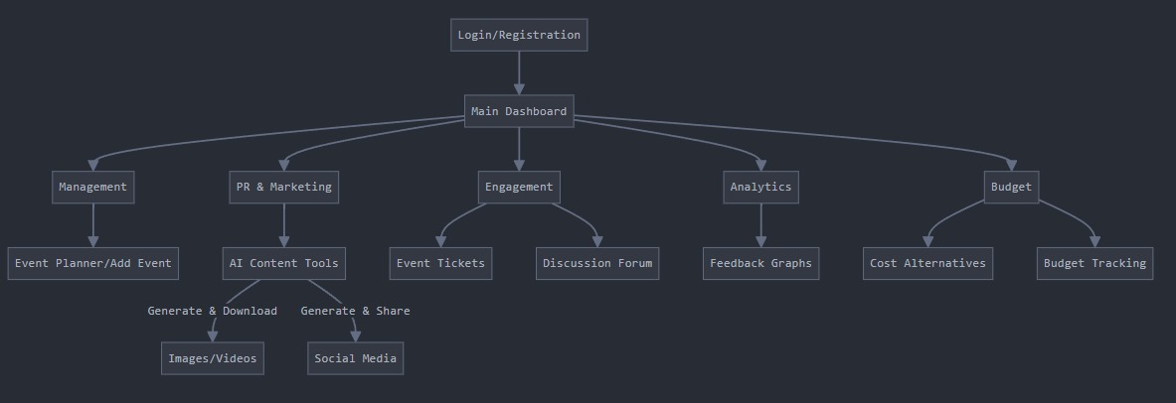
Flow of our project:

Slide 5
Demo:
https://youtu.be/d5bNXB_Cshs

Slide 6
Thank You

